Slide 1
2:8-3:7

Slide 2
2:8-3:7
Presbyterian
Episcopalian
Elder led
Shepherd led
congregational
Laity led

Slide 3
2:8-3:7

Slide 4
2:8-3:7
1 Timothy 2:8–3:7 ~ ⁸ I desire therefore that the men pray everywhere, lifting up holy hands, without wrath and doubting; ⁹ in like manner also, that the women adorn themselves in modest apparel, with propriety and moderation, not with braided hair or gold or pearls or costly clothing, ¹⁰ but, which is proper for women professing godliness, with good works. ¹¹ Let a woman learn in silence with all submission. ¹² And I do not permit a woman to teach or to have authority over a man, but to be in silence. ¹³ For Adam was formed first, then Eve. ¹⁴ And Adam was not deceived,
but the woman being deceived,

Slide 5
2:8-3:7
1 Timothy 2:8–3:7 ~ fell into transgression. ¹⁵ Nevertheless she will be saved in childbearing if they continue in faith, love, and holiness, with self-control.
^{3:1} This is a faithful saying: If a man desires the position of a bishop, he desires a good work. ² A bishop then must be blameless, the husband of one wife, temperate, sober-minded, of good behavior, hospitable, able to teach; ³ not given to wine, not violent, not greedy for money, but gentle, not quarrelsome, not covetous; ⁴ one who rules his own house well, having his children in submission
with all reverence

Slide 6
2:8-3:7
1 Timothy 2:8–3:7 ~ ⁵ (for if a man does not know how to rule his own house, how will he take care of the church of God?); ⁶ not a novice, lest being puffed up with pride he fall into the same condemnation as the devil. ⁷ Moreover he must have a good testimony among those who are outside, lest he fall into reproach and the snare of the devil.

Slide 7
2:8-3:7

Slide 8
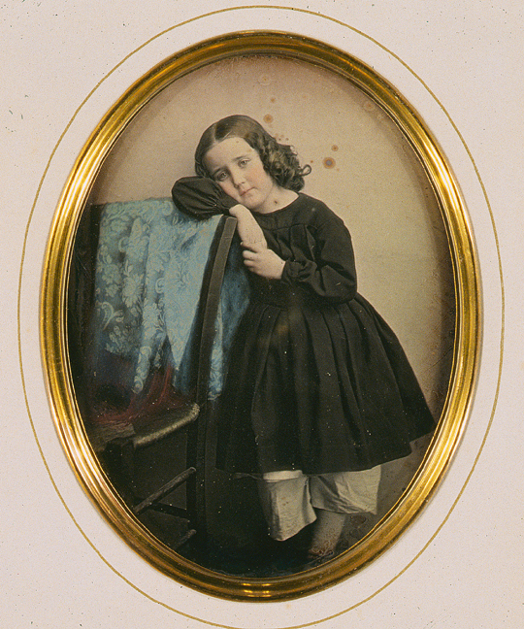
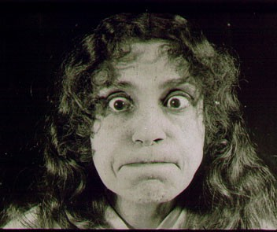
2:8-3:7
Henrietta Higginsbottom, c. 1872

Slide 9
2:8-3:7

Slide 10
2:8-3:7
men ~ andras – literally, “males”
Поднимите руки
Stick ‘em up!
ghoplIj pep
i to outou na rima
הרם את ידיך
Höj dina händer
بالا بردن دست خود را
kuinua mikono yako
levanten las manos
Levante as mãos
手を上げろ
Alzi le mani

Slide 11
2:8-3:7
men ~ andras – literally, “males”
Daddy!!

Slide 12
2:8-3:7
men ~ andras – literally, “males”
wrath ~ orgē – malevolent or violent intentions
dialogue
doubting ~ dialogizmos – the idea of arguing with oneself

Slide 13
2:8-3:7

Slide 14
2:8-3:7
NIV ~ I also want

Slide 15
2:8-3:7

Slide 16
2:8-3:7
J. Vernon McGee ~ “For some women, it’s a sin NOT to wear makeup”

Slide 17
2:8-3:7

Slide 18
2:8-3:7
silence (also v. 12) ~ hēsuchia
Thayer’s ~ “Description of the life of one who stays at home doing his own work, and does not officiously meddle with the affairs of others”
1 Tim. 2:2 ~ for kings and all who are in authority, that we may lead a quiet and peaceable life in all godliness and reverence.

Slide 19
2:8-3:7

Slide 20
2:8-3:7
1 Cor. 11:5 ~ But every woman who prays or prophesies with her head uncovered dishonors her head, for that is one and the same as if her head were shaved.

Slide 21
2:8-3:7

Slide 22
2:8-3:7
Is it scriptural for a woman to be either
pastoresses?
pastors?
or
elderesses?
elders?

Slide 23
2:8-3:7

Slide 24
2:8-3:7
2. Distinguish between cultural or universal application
1. Read passage in light of all other Scripture
3. Ask if passage addresses specific individual or group or all church

Slide 25
2:8-3:7
Three views:
1. Protected through pregnancy
Phillips ~ Nevertheless I believe that women will come safely through child-birth if they maintain a life of faith, love, holiness and gravity.

Slide 26
2:8-3:7
Three views:
2. Birth of the Messiah
ESV footnote: Gal. 4:4 ~ But when the fullness of time had come, God sent forth his Son, born of woman, born under the law,
3. Receiving their proper role
Living Bible ~ So God sent pain and suffering to women when their children are born, but he will save their souls if they trust in him, living quiet, good, and loving lives.

Slide 27
2:8-3:7
Three views:
NLT ~ But women will be saved through childbearing, assuming they continue to live in faith, love, holiness, and modesty.
NLT footnote ~ Or, will be saved by accepting their role as mothers, or will be saved by the birth of the Child.

Slide 28
2:8-3:7

Slide 29
2:8-3:7
bishop ~ episkopē – upon + to peer about
NIV, NASB – overseer
episkopē/episkopos (9x); presbuteros (67x) used interchangeably
elder man or “alderman”

Slide 30
2:8-3:7

Slide 31
2:8-3:7
blameless ~ literally, “cannot be laid hold of”
husband of one wife
1. Married
2. Never divorced
or, in some views, widowed
3. Not a polygamist
devoted ~ literally, “one woman man”
good behavior ~ kosmios – “well arranged” (cosmetics)

Slide 32
2:8-3:7
blameless ~ literally, “cannot be laid hold of”
husband of one wife
devoted ~ literally, “one woman man”
good behavior ~ kosmios – “well arranged” (cosmetics)
hospitable ~ literally, “lover of strangers” or “foreigners”
able to teach ~ the ability to understand God’s word and communicate it to others

Slide 33
2:8-3:7

Slide 34
2:8-3:7
given to wine ~ paroinos – para (with) + oinos (wine)
covetous ~ literally, “lover of silver”

Slide 35
2:8-3:7

Slide 36
2:8-3:7
novice ~ neophutos – neophyte

Slide 37
2:8-3:7

